Slide 1
Microsoft Azure DocumentDB
<Presenter name and role>

Slide 2
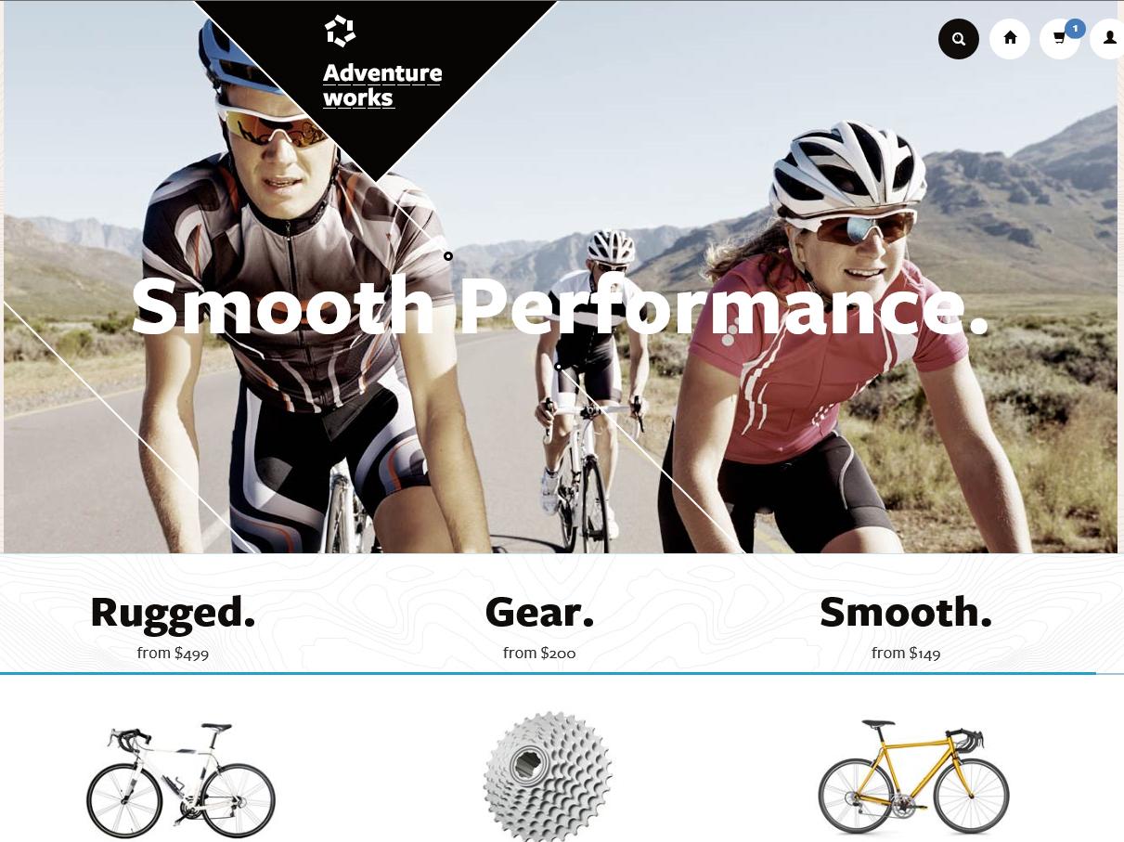
Today’s Modern Apps
Produce and consume data at a staggering rate while requiring instantaneous response times to match user expectations
Developed iteratively with many versions supported concurrently and continuously evolving data models
Increasingly complex, compensating for the lack of query and transactional processing in today’s NoSQL database systems
Experience unpredictable and explosive growth
Notes:
Now there are certain trends in modern application development that have surfaced in the last few years. These are - “Applications which…”
There are existing Azure services that meet the needs of one or more of the scenarios on this list, but DocumentDB meets the requirements demanded by all of these trends. DocumentDB fills a gap in the Azure data services portfolio.
We heard from internal and external customers that they didn’t want to run and manage NoSQL document stores especially at massive scale. Customers also told us they needed more of the query and transaction processing capabilities that are inherent to relational systems. So we considered what it would take to build a schema-free database with robust query and transaction processing using modern data formats, languages and protocols – the result of this effort is DocumentDB

Slide 3
DocumentDB is particularly suited for web and mobile applications
Catalog data
Preferences and state
Event store
User generated content
Data exchange
Notes:
So speaking of customers, let’s move on to some of the scenarios that we’ve seen DocDB used for. DocDB is particularly suited for web and mobile application development of all types, but a few scenarios seem to be great fit for the service and we’ve seen these scenarios in the private preview.
Catalog Data
Store, query and process entities – people, places, things
Evolve item schema and attributes based on application needs
Tune indexing to match query and performance needs
Examples include product catalogs, user profiles, device information i.e. IoT systems
Preferences and State
Store user preference data for application experiences and UI customization
Store application information including game state or device configuration information
Support cross document transactions i.e. item transfer or concurrent add/remove operations
Event Store
Process store and query device and application events in near real time i.e. IoT systems
Partition data as time-series or by source ID
Expose web APIs and application experiences over event data with diverse structure
Archive or delete data as it ages out
User Generated Content
Store user generated content such as blogs, comments, annotations.
Support varying properties based on consumption platform (web, mobile)
Rapidly evolve schema based on application needs
Data Exchange
Consume, aggregate and serve data from a variety of sources
Adapt to evolving schemas
Offer queries over heterogeneous document structures
Scale data consumption or delivery from disparate sources

Slide 4






How do we think about the different services?
SQL Server in a VM
SQL Database
DocumentDB
HBase
Tables/Blobs
fully featured RDBMS
rich query
transactional processing
managed as a service
elastic scale
schema-free data model
internet accessible http/rest
arbitrary data formats
Notes:
Presenter guidance:
Introduce the family portrait.
Slide talk track:
This is how we think about the core differences across the data services for capturing and managing data
On the left, you have more database imposed structure on the left and this loosens as you move to the right, ending in blobs which is just large containers of binary data.

Slide 5


Microsoft Azure DocumentDB
Microsoft Azure DocumentDB
{ “topic” : “intro”}
SQL Server in a VM
SQL Database
DocumentDB
HBase
Tables/Blobs
{ }
schema free query |  | Relational and hierarchical query of application defined JSON data. Support for SQL queries with transforms, projections and inline evaluation of user defined JavaScript functions (UDFs). Automatic and consistent indexing of all properties.
JavaScript as a modern T-SQL |  | Transactional execution of application defined stored procedures and triggers directly against database collections. Native JavaScript support eliminating the impedance mismatch between application and database schema.
tunable consistency |  | Well defined consistency levels to achieve optimal tradeoff between consistency and performance. Four distinct consistency levels for queries and read – Strong, Bounded-Staleness, Session and Eventual. Granular control over consistency, availability and latency
fully managed |  | Simple to provision and access databases without managing VM or cluster infrastructure. Operated with 99.95% availability and automatically backed up to prevent against regional failures

Slide 6
DocumentDB
NoSQL document database-as-a-service
First of its kind database service to offer native support for JavaScript, SQL query and transactions over JSON documents.
Rich Query and Transactions
over JSON Data
Reliable &
Predictable Performance
Rapid Development
Query JSON data with no secondary indices
Native JavaScript transactional processing
Familiar SQL-based query language
Fast, predictable performance
Tunable consistency
Elastic scale
Build with familiar tools – REST, JSON, JavaScript
Easy to start and fully-managed
Enterprise-grade Azure platform
Notes:
So what is DocumentDB?
DocumentDB is a NoSQL document database-as-a-service, fully managed by Microsoft Azure.
It is for cloud-designed apps when query over schema-free data; reliable and predictable performance; and rapid development are key. It’s the first of its kind database service to offer native support for JavaScript, SQL query and transactions over JSON documents.
The key benefits of DocDB can be broken down into three pillars. We'll go into a bit more detail into how DocDB is differentiated in the market based on these pillars.
Rich query and transaction over JSON data – which includes the concepts of query, automatic indexing, transactions, sql-like query language
Reliable and Predictable Performance – built for the cloud, tunable consistency, elastic
Rapid Development – benefits of being part of Azure, build with familiar tools (so you can bring your JSON data and take it away)
Together, you have a service that is perfect for cloud architects and developers who need an enterprise-ready NoSQL document database.

Slide 7
DocumentDB: A Document Store
DocumentDB
Collections
Document 1
Document 2
{
"name": "John",
"country": "Canada",
"age": 43,
"lastUse": "March 4, 2014"
}
{
"name": "Eva",
"country": "Germany",
"age": 25
}
SQL query
Application
Document 3
Document 4
JSON
Application
{
"name": "Lou",
"country": "Australia",
"age": 51,
"firstUse": "May 8, 2013"
}
{
"docCount": 3,
"last": "May 1, 2014"
}
Notes:
Source: https://msdn.microsoft.com/en-us/library/azure/dn781482.aspx
Microsoft Azure DocumentDB is a document-oriented, NoSQL database service designed for modern mobile and web applications. DocumentDB delivers consistently fast reads and writes, schema flexibility, and the ability to easily scale a database up and down on demand. DocumentDB enables complex ad hoc queries using a dialect of SQL, supports well defined consistency levels, and offers JavaScript language integrated, multi-document transaction processing using the familiar programming model of stored procedures, triggers and UDFs.

Slide 8

DocumentDB at Microsoft
over 425 million unique users
store 20TB of JSON document data
available globally to serve all markets
user data store
store for 40+ app / device combinations
under 15ms writes and single digit ms reads

Slide 9
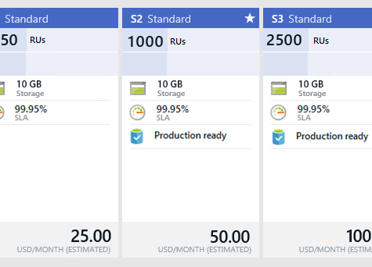
What Does DocumentDB Cost?
Pricing for General Availability
Standard pricing tier with hourly billing
S1, S2 and S3 units differentiated by performance (good, better, best)
Performance levels assigned during collection (data partition) creation
Performance levels can be adjusted based on application needs
Each collection includes 10GB of SSD storage
Limit of 100 collections (1 TB) for each account – can be lifted as needed
Notes:
Source: http://azure.microsoft.com/en-us/pricing/details/documentdb/
DocumentDB is a highly scalable, NoSQL document database service offering rich query and transactional processing over a schema-free JSON data model. The service helps you quickly build, grow, and scale applications that run in the cloud when predictable throughput, low latency, and flexible queries are key.

Slide 10
Provision a DocumentDB Account

Slide 12
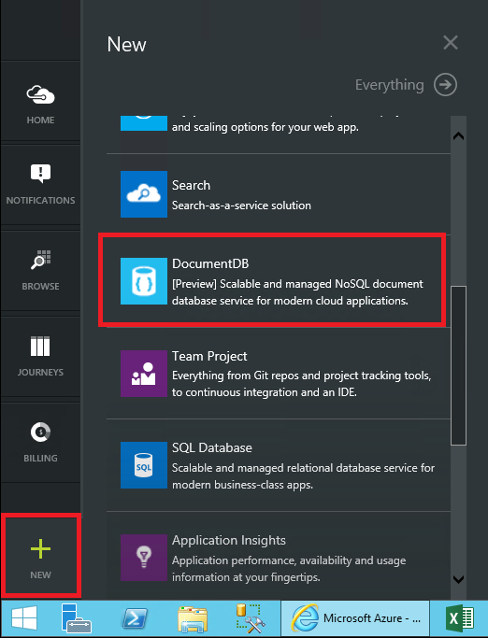
Create a New Account
Start from the Azure Portal to create a DocumentDB service
Notes:
Source: http://azure.microsoft.com/en-us/documentation/articles/documentdb-create-account/

Slide 13
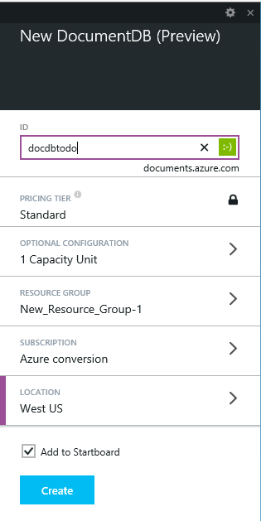
Provide the Service Name
Provide a name for your service that will be used as part of the endpoint URI
Define resource groups, capacity units, and service location
Notes:
Source: http://azure.microsoft.com/en-us/documentation/articles/documentdb-create-account/

Slide 14
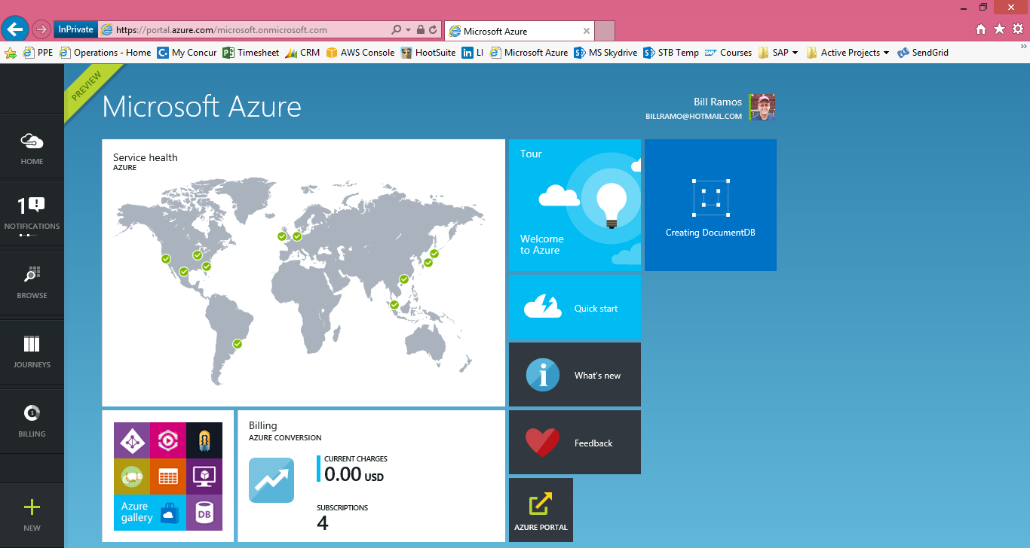
Complete Provisioning
The Azure portal provides notifications to let you know the provisioning status
Notes:
Source: http://azure.microsoft.com/en-us/documentation/articles/documentdb-create-account/

Slide 15
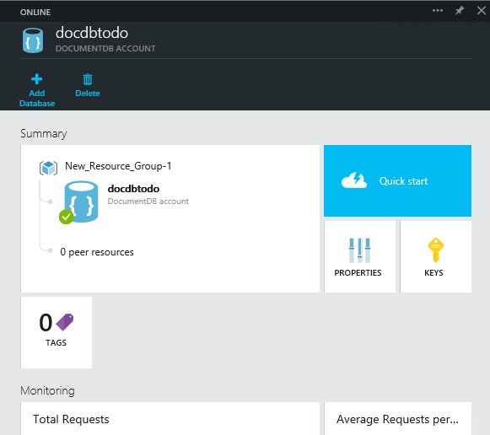
DocumentDB Account Blade
The account blade provides you with essential information about your service
Click on Quick start to see the latest resources for your service
Notes:
Source: http://azure.microsoft.com/en-us/documentation/articles/documentdb-create-account/

Slide 16
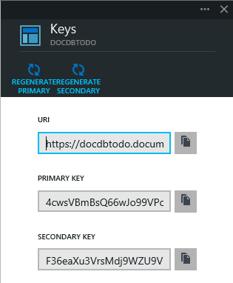
Viewing Service Keys
DocumentDB includes primary and secondary keys for rolling key updates
Notes:
Source: http://azure.microsoft.com/en-us/documentation/articles/documentdb-create-account/

Slide 17
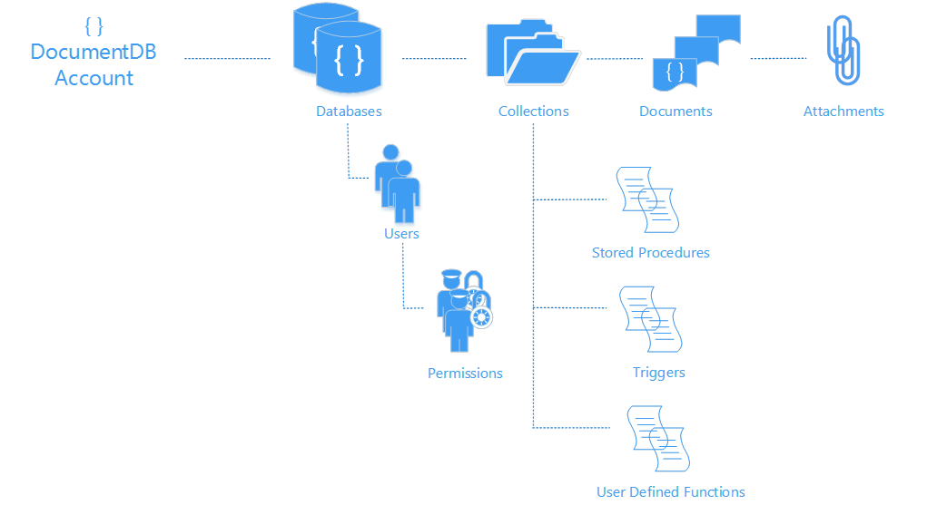
The Basics
Resource model
Entities addressable by logical URI
Partitioned for scale out
Replicated for high availability
Entities represented as JSON
Accounts scale out through addition of capacity units
Interaction model
RESTful interaction over HTTP
HTTP and TCP connectivity
Standard HTTP verbs and semantics
Development
.Net, Node, Python, Java and JavaScript clients
SQL for query expression, .Net LINQ
JavaScript for server-side app logic
/dbs/{id}
/colls/{id}
/docs/{id}
/attachments/{id}
/users/{id}
/sprocs/{id}
/permissions/{id}
/triggers/{id}
/functions/{id}
https://myaccountname.documents.azure.net/dbs/{id}/colls/{id}/docs/{id}
Notes:
Source: http://azure.microsoft.com/en-us/documentation/articles/documentdb-resources/
As the following diagram illustrates, the DocumentDB resource model consists of sets of resources under a database account, each addressable via a logical and stable URI. A set of resources is referred to as a feed in this article.
Hierarchical resource model under a database account
To start working with resources, you must create a DocumentDB database account using your Azure subscription.
A database account can consist of a set of databases, each containing multiple collections, each of which in-turn contain stored procedures, triggers, UDFs, documents and related attachments. A database also has associated users, each with a set of permissions to access collections, stored procedures, triggers, UDFs, documents or attachments. While databases, users, permissions and collections are system-defined resources with well-known schemas, documents and attachments contain arbitrary, user defined JSON content.
Database account. A database account is associated with one or more capacity units representing provisioned document storage and throughput, a set of databases and blob storage. You can create one or more database accounts using your Azure subscription.
Database. A database is a logical container of document storage partitioned across collections. It is also a users container.
User. The logical namespace for scoping/partitioning permissions.
Permission. An authorization token associated with a user for authorized access to a specific resource.
Collection. A collection is a container of JSON documents and the associated JavaScript application logic.
Stored Procedure. Application logic written in JavaScript which is registered with a collection and transactionally executed within the database engine.
Trigger. Application logic written in JavaScript modeling side effects associated with insert, replace or delete operations.
UDF. A side effect free, application logic written in JavaScript. UDFs enable you to model a custom query operator and thereby extend the core DocumentDB query language.
Document. User defined (arbitrary) JSON content. By default, no schema needs to be defined nor do secondary indices need to be provided for all the documents added to a collection.
Attachment. Attachment are special documents containing references and associated metadata for external blob/media. The developer can choose to have the blob managed by DocumentDB or store it with an external blob service provider such as OneDrive, Dropbox, etc.

Slide 18
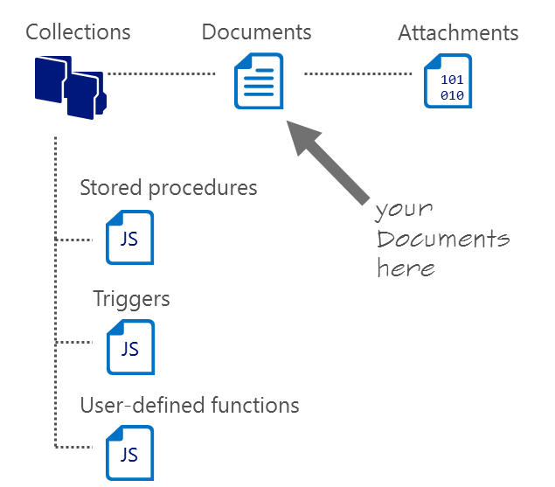
DocumentDB Collections
Collections != tables
Unit of partitioning
Transaction boundary
No enforced schema, flexible
Queried or updated stay together in one collection -
Size of 10 Gb
Notes:
Source: http://azure.microsoft.com/en-us/documentation/articles/documentdb-resources/
A DocumentDB collection is a container for your JSON documents. A collection is also a unit of scale for transactions and queries. You can scale out a DocumentDB database by adding more collections. If your application needs to scale more, you can provision more SSD backed document storage (and throughput) and distribute it across the collections of one or more databases under your database account.

Slide 19
DocumentDB JSON Documents
{
“locations”:
[
{“country”: “Germany”, “city”: “Berlin”},
{“country”: “France”, “city”: “Paris”},
],
“headquarter”: “Belgium”,
“exports”:[{“city”; “Moscow”},{“city: ”Athens”}]
};
JSON document as tree
JSON
Intersection of most modern type systems
JSON values
Self-describable, self-contained values
Do not have behavior, polymorphism, inheritance, access, and visibility rules”
Are trivially serialized to/from text
DocumentDB makes a deep commitment to JSON for storage, indexing, query, and JavaScript execution
Locations
Headquarter
Exports
0
1
Belgium
0
1
Country
City
Country
City
City
City
Germany
Berlin
France
Paris
Moscow
Athens
Notes:
Source: http://azure.microsoft.com/en-us/documentation/articles/documentdb-resources/#documents
You can insert, replace, delete, read, enumerate and query arbitrary JSON documents in a collection. DocumentDB does not mandate any schema and does not require secondary indexes in order to support querying over documents in a collection.
Being a truly open database service, DocumentDB does not invent any specialized data types (e.g. date time) or specific encodings for JSON documents. Note that DocumentDB does not require any special JSON conventions to codify the relationships among various documents; the SQL query language of DocumentDB provides very powerful hierarchical and relational query operators to query and project documents without any special annotations or need to codify relationships among documents using distinguished properties.
As with all other resources, documents can be created, replaced, deleted, read, enumerated and queried easily using either REST APIs or any of the client SDKs. Deleting a document instantly frees up the quota corresponding to all of the nested attachments. The read consistency level of documents follows the consistency policy on the database account. This policy can be overridden on a per-request basis depending on data consistency requirements of your application. When querying documents, the read consistency follows the indexing mode set on the collection. For “consistent”, this follows the account’s consistency policy.

Slide 20
DocumentDB JSON Documents
value
string
numbers
JSON serializable values
(aka JSON Infoset)
object
array
JSON
true
false
null
JavaScript Object Literals
object
{
string
:
value
}
,
array
{
value
}
,
Notes:
Reference: http://en.wikipedia.org/wiki/JSON
Data types, syntax and example
JSON's basic types are:
Number — a signed decimal number that may contain a fractional part and may use exponential E notation. JSON does not allow non-numbers like NaN, nor does it make any distinction between integer and floating-point. (Even though JavaScript uses a double-precision floating-point format for all its numeric values, other languages implementing JSON may encode numbers differently)
String — a sequence of zero or more Unicode characters. Strings are delimited with double-quotation marks and support a backslash escaping syntax.
Boolean — either of the values true or false
Array — an ordered list of zero or more values, each of which may be of any type. Arrays use square bracket notation with elements being comma-separated.
Object — an unordered collection of name/value pairs where the names (also called keys) are strings. Since objects are intended to represent associative arrays,^{[10]} it is recommended, though not required,^{[11]} that each key is unique within an object. Objects are delimited with curly brackets and use commas to separate each pair, while within each pair the colon ':' character separates the key or name from its value.
null — An empty value, using the word null
JSON generally ignores any whitespace around or between syntactic elements (values and punctuation, but not within a string value). However JSON only recognizes four specific whitespace characters: the space, horizontal tab, line feed, and carriage return. JSON does not provide or allow any sort of comment syntax.

Slide 21
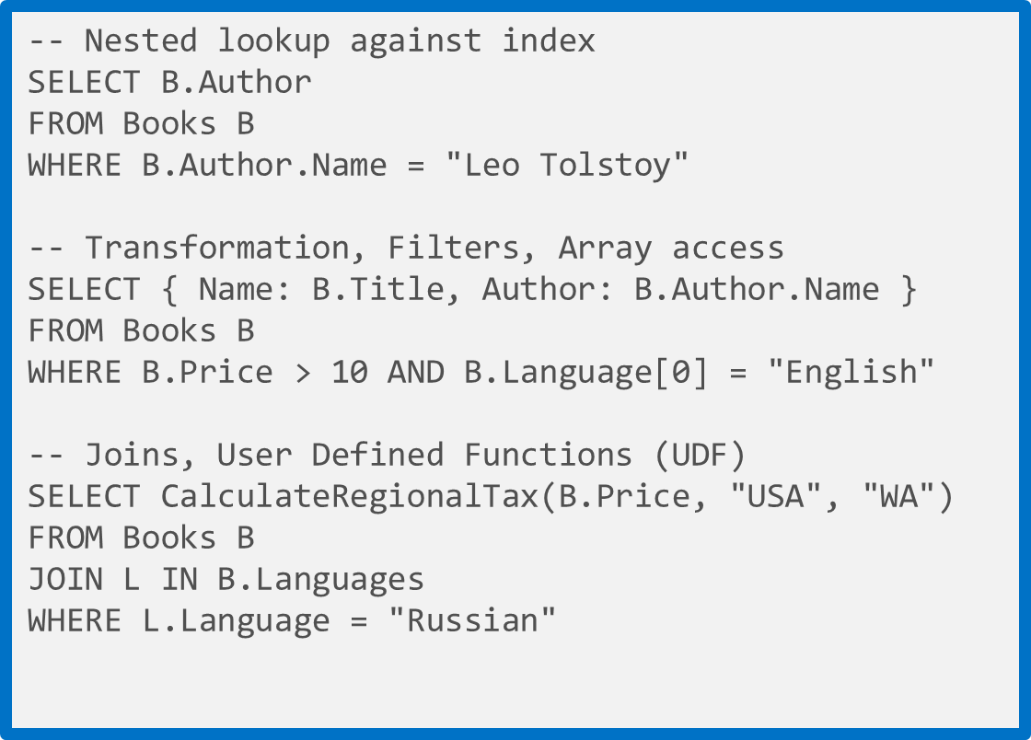
Rich Query Over JSON Data
Query JSON data without specifying secondary indices or constructing views
No forced, pre-defined indices allow for differentiated querying
Native JavaScript transactional processing
Easy integration with web platforms and tools
Familiar SQL-based query language
Query over multiple documents using familiar commands
Notes:
All the data that is brought into the database is automatically indexed and is immediately queryable. No secondary indexes are necessary. You use a SQL query grammar which will be familiar to customers. In addition to querying, DocDB supports JavaScript transaction processing. The best way to think about this is JavaScript is to DocDB as T-SQL is to SQL Server. With JavaScript, you can run server side logic in the form of stored procedures, triggers, and user-defined functions. These run as atomic transactions just like in relational stores, so if something fails halfway through, the data is rolled back to before the transaction began.

Slide 22
Rich Query Over JSON Data
-- Nested lookup against index
SELECT B.Author
FROM Books B
WHERE B.Author.Name = "Leo Tolstoy"
-- Transformation, Filters, Array access
SELECT { Name: B.Title, Author: B.Author.Name }
FROM Books B
WHERE B.Price > 10 AND B.Language[0] = "English"
-- Joins, User Defined Functions (UDF)
SELECT CalculateRegionalTax(B.Price, "USA", "WA")
FROM Books B
JOIN L IN B.Languages
WHERE L.Language = "Russian"
LINQ for .NET developers and a “document oriented“ SQL grammar for traditional SQL developers
Extend query execution through application-supplied JavaScript UDFs
Supported SQL features; predicates, iterations (arrays), sub-queries, logical operators, UDFs, intra-document JOINs, or JSON transforms
Notes:
Source: http://azure.microsoft.com/en-us/documentation/articles/documentdb-sql-query/
Microsoft Azure DocumentDB supports querying documents using SQL (Structured Query Language) over hierarchical JSON documents. DocumentDB is truly schema-free. By virtue of its commitment to the JSON data model directly within the database engine, it provides automatic indexing of JSON documents without requiring explicit schema or creation of secondary indexes. While designing the query language for DocumentDB we had two goals in mind:
Embrace SQL – Instead of inventing a new query language, we wanted to embrace the SQL language. After all, SQL is one of the most familiar and popular query languages. DocumentDB SQL query language provides a formal programming model for rich queries over JSON documents.
Extend SQL – As a JSON document database capable of executing JavaScript directly in the database engine, we wanted to use JavaScript's programming model as the foundation for our SQL query language. The DocumentDB SQL query language is rooted in JavaScript's type system, expression evaluation, and function invocation. This in-turn provides a natural programming model for relational projections, hierarchical navigation across JSON documents, self joins, and invocation of user defined functions (UDFs) written entirely in JavaScript, among other features.
We believe that these capabilities are key to reducing the friction between the application and the database and are crucial for developer productivity.

Slide 23
Simple Predicate Query
Var company1= { “locations” : [
{“country”: “Germany”, “city”: “Berlin”},
{“country”: “France”, “city”: “Paris”},
], “headquarter”: “Belgium”, “exports”: [
{ “city”; “Moscow” },{ “city: ”Athens” }]
};
Var company2= { “locations” :
[{“country”: “Germany”, “city”: “Bonn”, revenue”: 200 } ], “headquarter”: “Italy”, “exports”: [ { “city”; “Berlin” },{ “dealers”: [{“name”: “Hans”}] }, {city”: ”Athens” }]
};
Locations
Headquarter
Exports
Locations
Headquarter
Exports
0
Italy
0
1
0
1
Belgium
0
1
Country
City
Revenue
City
Dealers
City
Country
City
Country
City
City
City
Germany
Bonn
200
Berlin
Name
Athens
Germany
Berlin
France
Paris
Moscow
Athens
Hans
SQL | SELECT * FROM company C WHERE C.headquarter = 'Belgium'
Results | [ { "locations": [{ "country": "Germany", "city": "Berlin" },{ "country": "France", "city": "Paris" }], "headquarter": "Belgium", "exports": [{ "city": "Moscow" },{ "city": "Athens" } ] }]

Slide 24
Iteration Query
Var company1= { “locations” : [
{“country”: “Germany”, “city”: “Berlin”},
{“country”: “France”, “city”: “Paris”},
], “headquarter”: “Belgium”, “exports”: [
{ “city”; “Moscow” },{ “city: ”Athens” }]
};
Var company2= { “locations” :
[{“country”: “Germany”, “city”: “Bonn”, revenue”: 200 } ], “headquarter”: “Italy”, “exports”: [ { “city”; “Berlin” },{ “dealers”: [{“name”: “Hans”}] }, {city”: ”Athens” }]
};
Locations
Headquarter
Exports
Locations
Headquarter
Exports
0
Italy
0
1
0
1
Belgium
0
1
Country
City
Revenue
City
Dealers
City
Country
City
Country
City
City
City
Germany
Bonn
200
Berlin
Name
Athens
Germany
Berlin
France
Paris
Moscow
Athens
Hans
SQL | SELECT * FROM company C WHERE C.headquarter = 'Belgium'
Results | [ {"country": "Germany"}, {"country": "France"}, {"country": "Germany"} ]

Slide 25
Querying Array with Predicates
Var company1= { “locations” : [
{“country”: “Germany”, “city”: “Berlin”},
{“country”: “France”, “city”: “Paris”},
], “headquarter”: “Belgium”, “exports”: [
{ “city”; “Moscow” },{ “city: ”Athens” }]
};
Var company2= { “locations” :
[{“country”: “Germany”, “city”: “Bonn”, revenue”: 200 } ], “headquarter”: “Italy”, “exports”: [ { “city”; “Berlin” },{ “dealers”: [{“name”: “Hans”}] }, {city”: ”Athens” }]
};
Locations
Headquarter
Exports
Locations
Headquarter
Exports
0
Italy
0
1
0
1
Belgium
0
1
Country
City
Revenue
City
Dealers
City
Country
City
Country
City
City
City
Germany
Bonn
200
Berlin
Name
Athens
Germany
Berlin
France
Paris
Moscow
Athens
Hans
SQL | SELECT location.country FROM location IN company.locations WHERE location.city = 'Berlin'
Results | [ {"country": "Germany"} ]

Slide 26
Query with Logical Operators
Var company1= { “locations” : [
{“country”: “Germany”, “city”: “Berlin”},
{“country”: “France”, “city”: “Paris”},
], “headquarter”: “Belgium”, “exports”: [
{ “city”; “Moscow” },{ “city: ”Athens” }]
};
Var company2= { “locations” :
[{“country”: “Germany”, “city”: “Bonn”, revenue”: 200 } ], “headquarter”: “Italy”, “exports”: [ { “city”; “Berlin” },{ “dealers”: [{“name”: “Hans”}] }, {city”: ”Athens” }]
};
Locations
Headquarter
Exports
Locations
Headquarter
Exports
0
Italy
0
1
0
1
Belgium
0
1
Country
City
Revenue
City
Dealers
City
Country
City
Country
City
City
City
Germany
Bonn
200
Berlin
Name
Athens
Germany
Berlin
France
Paris
Moscow
Athens
Hans
SQL | SELECT location.country FROM location IN company.locations WHERE location.city='Bonn' AND location.revenue >100
Results | [ {"country": "Germany"} ]

Slide 27
Query with UDFs
Var company1= { “locations” : [
{“country”: “Germany”, “city”: “Berlin”},
{“country”: “France”, “city”: “Paris”},
], “headquarter”: “Belgium”, “exports”: [
{ “city”; “Moscow” },{ “city: ”Athens” }]
};
Var company2= { “locations” :
[{“country”: “Germany”, “city”: “Bonn”, revenue”: 200 } ], “headquarter”: “Italy”, “exports”: [ { “city”; “Berlin” },{ “dealers”: [{“name”: “Hans”}] }, {city”: ”Athens” }]
};
Locations
Headquarter
Exports
Locations
Headquarter
Exports
0
Italy
0
1
0
1
Belgium
0
1
Country
City
Revenue
City
Dealers
City
Country
City
Country
City
City
City
Germany
Bonn
200
Berlin
Name
Athens
Germany
Berlin
France
Paris
Moscow
Athens
Hans
SQL | SELECT GermanTax(location) FROM location in company.locations
Results | [ {"country": "Germany", "city":"Bonn", "tax":50}, {"country": "Germany", "city":"Berlin", "tax":0}, ]
function GermanTax(income) {
if(income < 1000) return income * 0.1;
else if(income < 10000) return income * 0.2;
return income * 0.4;
}

Slide 28
Query Performance – Pagination
When performing a bulk read of documents or issuing a query, the server returns results in a segmented fashion if the result set is too large.
In order to reduce round-trips, clients may override the page size.
Bounded execution time of 5 seconds per batch
Default page size is 100 (server returns results in chunks of at most 100)
Desired page size can be specified:
Use x-ms-max-item-count request header
Use FeedOptions.MaxItemCount property

Slide 29
.NET SQL Parameterization in DocumentDB
IQueryable<Book>
queryable = client.CreateDocumentQuery<Book>(
collectionSelfLink,
new SqlQuerySpec
{
QueryText = "SELECT * FROM books b WHERE (b.Author.Name = @name)",
Parameters = new SqlParameterCollection()
{
new SqlParameter( "@name",
"Herman Melville")
}
}
);
SQL parameters use the familiar @ notation borrowed from T-SQL.
Parameter values can be any valid JSON values (strings, numbers, Booleans, null, even arrays or nested JSON).
Since DocumentDB is schema-less, parameters are not validated against any type.
Supply additional parameters by adding SqlParameters to the SqlParameterCollection.
Notes:
Source: http://blogs.msdn.com/b/documentdb/archive/2015/01/15/announcing-sql-parameterization-in-documentdb.aspx
We are pleased to announce support for parameterized SQL queries in the Azure DocumentDB REST API and SDKs. Using this feature, you can now write parameterized SQL queries. Parameterized SQL provides robust handling and escaping of user input, preventing accidental exposure of data through “SQL injection” *.
Let's take a look at a sample using the .NET SDK; In addition to plain SQL strings and LINQ expressions, we've added a new SqlQuerySpec class that can be used to build parameterized queries. Here's a sample that queries a "Books" collection with a single user supplied parameter for author name.

Slide 30
Parameterized Query with User-Defined Function
// User Defined Function
function tax(doc) {
// Use simple formula to compute the tax: use income multiplied by factor based on country of headquarters.
var factor =
doc.headquarters == "USA" ? 0.35 :
doc.headquarters == "Germany" ? 0.3 :
doc.headquarters == "Russia" ? 0.2 :
0;
// Check for bad data.
if (factor == 0)
{
throw new Error("Unsupported country: " +
doc.headquarters);
}
// Use simple formula and return.
return doc.income * factor;
}
// Execute UDF with additional condition
var results = client.CreateDocumentQuery<dynamic>(colSelfLink, string.Format("SELECT r.name AS company, Tax(r) AS tax FROM root r WHERE r.type='Company'", udfId));
The complexity of a query impacts the request units consumed for an operation.
Number of predicates
More predicates result in a larger request charge.
Additional predicates can help if they result in narrowing the result set.
Use of user-defined functions (UDFs)
To take advantage of indexing, include at least one filter against an indexed property.
Tip: For all operations, the cost of any given request can be inferred by inspecting the x-ms-request-charge response header.
Notes:
Source: http://azure.microsoft.com/en-us/documentation/articles/documentdb-programming/#udf
User-defined functions
User-defined functions (UDFs) are used to extend the DocumentDB SQL query language grammar and implement custom business logic. They can only be called from inside queries. They do not have access to the context object and are meant to be used as compute-only JavaScript. Therefore, UDFs can be run on secondary replicas of the DocumentDB service.

Slide 31
REST SQL Parameterization
POST https://contosomarketing.documents.azure.com/dbs/XP0mAA==/colls/XP0mAJ3H-AA=/docs
HTTP/1.1 x-ms-documentdb-isquery: True
x-ms-date: Mon, 18 Aug 2014 13:05:49 GMT
authorization: type%3dmaster%26ver%3d1.0%26sig%3dkOU%2bBn2vkvIlHypfE8AA5fulpn8zKjLwdrxBqyg0YGQ%3d
x-ms-version: 2014-08-21
Accept: application/json
Content-Type: application/query+json
Host: contosomarketing.documents.azure.com
Content-Length: 50
{
"query": "SELECT * FROM books b WHERE
(b.Author.Name = @name)",
"parameters":
[
{
"name": "@name",
"value": "Herman Melville“
}
]
}
Specify the Content-Type Header as application/query+json and the query as JSON in the body.
Notes:
Source: http://blogs.msdn.com/b/documentdb/archive/2015/01/15/announcing-sql-parameterization-in-documentdb.aspx
The DocumentDB REST API also natively supports parameterization. The .NET sample shown above translates to the following REST API call. To use parameterized queries, you need to specify the Content-Type Header as application/query+json and the query as JSON in the body, as shown

Slide 32
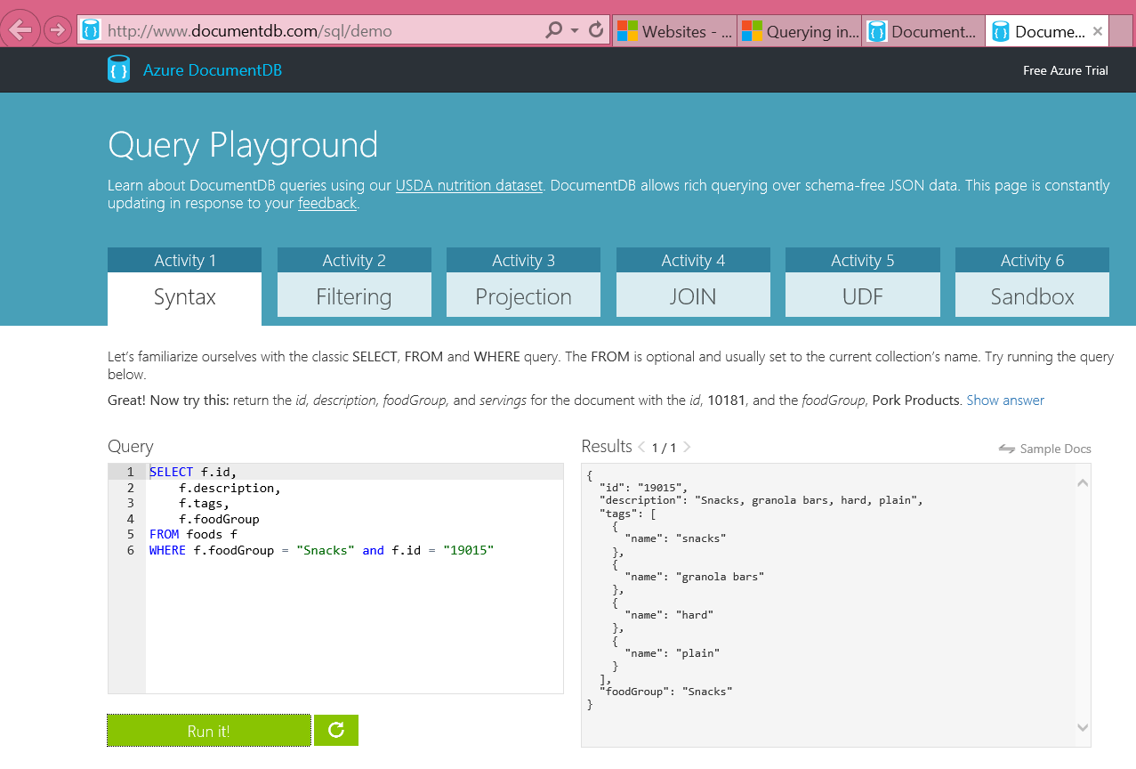
DocumentDB Query Playground
http://www.documentdb.com/sql/demo
Test out sample queries or write your own against the dataset
Notes:
Source: http://www.documentdb.com/sql/demo
Learn about DocumentDB queries using our USDA nutrition dataset. DocumentDB allows rich querying over schema-free JSON data. This page is constantly updating in response to your feedback.

Slide 33
Query with SQL
http://www.documentdb.com/sql/demo
Notes:
See http://azure.microsoft.com/en-us/documentation/articles/documentdb-sql-query/ for demo scenario
Video of sequence at http://azure.microsoft.com/en-us/documentation/videos/dataexposedqueryingdocumentdb/

Slide 34
Create, Get, Replace, Delete Overview

Slide 35
Programmability
client = new DocumentClient(new Uri(endpointUrl), authKey);
Database database = await client.CreateDatabaseAsync(new Database{Id = “myNewDatabase”});
DocumentCollection collection = await client.CreateDocumentCollectionAsync(database.SelfLink, new DocumentCollection{Id = “Pages"});
Page page = new Page
{
Id = "Sample",
Title = "About Paris",
Language = new Language { Name = "English" },
Author = new Author { Name = "Don” },
Content = "Don's document in DocDB is a valid JSON document",
PageViews = 10000,
Topics = new Topic[] {
new Topic { Title = "History" },
new Topic { Title = "Places to see" }}
};
ResourceResponse<Document> resp = await client.CreateDocumentAsync(collection.DocumentsLink, page);
Broad language and platform support
REST/HTTP APIs
C#, Node.js, JavaScript and Python SDKs for Public Preview
SDKs open sourced through GitHub
C# Client SDK
Supports gateway and direct connectivity
Async APIs for all operations
HTTP and TCP transports available
POCOs, inherited document types and dynamics
LINQ provider for query execution

Slide 36
Create Document: POST
POST https://contosomarketing.documents.azure.com/dbs/ehszAA==/colls/ehszALxRRgA=/docs HTTP/1.1
Host: contosomarketing.documents.azure.com
{"id":"Book2","Title":"About Seattle","Language":{"id":"English"},"Author":{"id":"Fred","Location":{"City":"Seattle","Country":"United States"}},"Synopsis":"Seattle, the largest city in the U.S. Pacific Northwest...","Pages":400,"Topics":[{"Title":"History of Seattle"},{"Title":"Places to see in in Seattle"}]}
Create a new document.
By default a document is automatically indexed.
If automatic indexing is turned off at the collection level, you can manually include or exclude documents from being indexed by using the x-ms-indexing-directive header during POST.
Notes:
Source: https://msdn.microsoft.com/en-us/library/azure/dn803948.aspx
A new document can be created by executing an HTTPS POST request against the docs URI resource path.
Documents are automatically indexed. If automatic indexing is turned off at the collection level, documents can be manually included or excluded from being indexed by using the x-ms-indexing-directive header during the POST operation .Documents must adhere to size limits, as specified in DocumentDB Limits.

Slide 37
Retrieve Document: GET
GET https://contosomarketing.documents.azure.com/dbs/-yI8AA==/colls/-yI8AKNuyAA=/docs/-yI8AKNuyAANAAAAAAAAAA== HTTP/1.1
Host: contosomarketing.documents.azure.com
RESPONSE
{"Title":"About St. Louis","Language":{"id":"English"},"id":"ISBN0-8800-1599-1","_rid":"-yI8AKNuyAANAAAAAAAAAA==","_ts":1408333905,"_self":"dbs\/-yI8AA==\/colls\/-yI8AKNuyAA=\/docs\/-yI8AKNuyAANAAAAAAAAAA==\/","_etag":"00005c00-0000-0000-0000-53f178510000","_attachments":"attachments\/"}
Retrieve user-defined JSON elements and system properties of the document.
Read consistency can be overridden to meet the needs of the application. The override is set per GET operation in the x-ms-consistency-level header.
Consistency override can be the same or weaker than the level that was set during account creation.
Notes:
Source: https://msdn.microsoft.com/en-us/library/azure/dn803957.aspx
Performing a GET operation on a specific document resource retrieves the user defined JSON elements and system properties of the document. While consistency level is defined at the database account level during account creation, read consistency can be overridden to suffice the need of the application. The override is set per GET operation by setting the x-ms-consistency-level header to the desired level. The rule of thumb is that the consistency override can only be the same or weaker than the level that was set during account creation. For instance, if during account creation the consistency level was set to Session, the override cannot be Strong or Bounded. For information on consistent level, see Consistency levels in DocumentDB.

Slide 38
Replace Document: PUT
PUT https://contosomarketing.documents.azure.com/dbs/ehszAA==/colls/ehszALxRRgA=/docs/XP0mAJ3H-AACAAAAAAAAAA== HTTP/1.1
Host: contosomarketing.documents.azure.com
{"id":"ISBDN 0-1231-1231-1","Title":"About Seattle","Language":{"id":"English"},"Author":{"id":"Fred","Location":{"City":"Seattle","Country":"United States"}},"Synopsis":"Seattle, the largest city in the U.S. Pacific Northwest...","Pages":400,"Topics":[{"Title":"History of Seattle"},{"Title":"Places to see in in Seattle"}]}
Replace the entire document resource on a specific document.
All user settable properties, including the id and the user-defined JSON elements, must be submitted in the body to perform the replacement.
Any element omissions will result in unintended data loss as this operation is a full replace operation.
The x-ms-indexing-directive header can be set and submitted for the operation to include or exclude the document from being indexed.
Notes:
Source: https://msdn.microsoft.com/en-us/library/azure/dn803947.aspx
Performing a PUT operation on a specific document resource replaces the entire document resource. All user settable properties, including the id, and the user defined JSON elements must be submitted in the body to perform the replacement. Any element omissions result in unintended data loss as this operation is a full replace operation. The x-ms-indexing-directive header can be set and submitted for the operation to include or exclude the document from being indexed.

Slide 39
Delete Document
DELETE https://contosomarketing.documents.azure.com/dbs/XP0mAA==/colls/XP0mAJ3H-AA=/docs/XP0mAJ3H-AAFAAAAAAAAAA== HTTP/1.1
Accept: application/json
Host: contosomarketing.documents.azure.com
RESPONSE
HTTP/1.1 204 No Content
Content-Length: 0
Content-Type: application/json
Content-Location: https://contosomarketing.documents.azure.com/dbs/XP0mAA==/colls/XP0mAJ3H-AA=/docs/XP0mAJ3H-AAFAAAAAAAAAA==
Delete the document resource from the collection.
204 is returned when the delete operation is successful.
404 is returned when the document does not exist (the document may have already been deleted).
Notes:
Source: https://msdn.microsoft.com/en-us/library/azure/dn803952.aspx
Performing a DELETE operation on a specific document resource deletes the document resource from the collection.

Slide 40
DocumentDB Transactions and Indexing

Slide 41
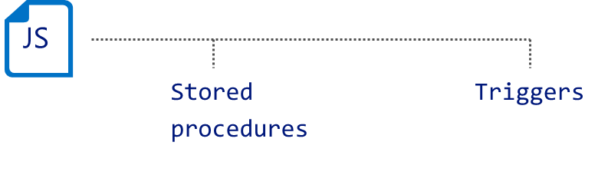
JavaScript Transactions
Transactionally process multiple documents with application-defined stored procedures and triggers
JavaScript as the procedural language
Execution wrapped in an implicit transaction
Preregistered and scoped to a collection
Performed with ACID guarantees
Triggers invoked as pre- or post-operations
Notes:
Source: http://azure.microsoft.com/en-us/documentation/articles/documentdb-programming/#transactions
Transaction in a typical database can be defined as a sequence of operations performed as a single logical unit of work. Each transaction provides ACID guarantees. ACID is a well-known acronym that stands for four properties - Atomicity, Consistency, Isolation and Durability.
Briefly, atomicity guarantees that all the work done inside a transaction is treated as a single unit where either all of it is committed or none. Consistency makes sure that the data is always in a good internal state across transactions. Isolation guarantees that no two transactions interfere with each other – generally, most commercial systems provide multiple isolation levels that can be used based on the application needs. Durability ensures that any change that’s committed in the database will always be present.
In DocumentDB, JavaScript is hosted in the same memory space as the database. Hence, requests made within stored procedures and triggers execute in the same scope of a database session. This enables DocumentDB to guarantee ACID for all operations that are part of a single stored procedure/trigger.

Slide 42
JavaScript Transactions
Stored procedures and triggers
Registered as named, URI addressable, durable resources
Scoped to a DocumentDB collection
JavaScript as a procedural language to express business logic
Language integration
JavaScript throw statement aborts the transaction
Execution
JavaScript runtime is hosted on each replica
Pre-compiled on registration
Entire procedure is wrapped in an implicit database transaction
Execution is fully resource governed and sandboxed
client.executeStoredProcedureAsync
("procs/1234", "MasterChief", "SolidSnake") .then(function (response) { console.log(“success!"); }, function (err) { console.log("Failed to swap!", error); } );
Client
function(playerId1, playerId2) { var collection = getContext().getCollection();
var playersToSwap = collection.filterDocuments(function (document) { return (document.id == playerId1 || document.id == playerId2); }); var player1 = playersToSwap[0], player2 = playersToSwap[1]; var player1ItemTemp = player1.item; player1.item = player2.item; player2.item = player1ItemTemp;
collection.replaceDocument(player1) .then(function() { return collection.replaceDocument(player2); }) .fail(function(error){ throw 'Unable to update players, abort'; }); }
Database
Notes:
Reference: http://azure.microsoft.com/en-us/documentation/articles/documentdb-programming/
DocumentDB’s language integrated, transactional execution of JavaScript lets developers write stored procedures, triggers and user defined functions (UDFs) natively in JavaScript. This allows developers to write application logic which can be shipped and executed directly on the database storage partitions.
This approach of “*JavaScript as a modern day T-SQL*” frees application developers from the complexities of type system mismatches and object-relational mapping technologies. It also has a number of intrinsic advantages that can be utilized to build rich applications:
Procedural Logic: JavaScript as a high level programming language, provides a rich and familiar interface to express business logic. You can perform complex sequences of operations closer to the data.
Atomic Transactions: DocumentDB guarantees the database operations performed inside a single stored procedure or trigger to be atomic. This lets an application combine related operations in a single batch so that either all of them succeed or none do.
Performance: The fact that JSON is intrinsically mapped to the Javascript language type system and is also the basic unit of storage in DocumentDB allows for a number of optimizations like lazy materialization of JSON documents in the buffer pool and making them available on-demand to the executing code. There are more performance benefits associated with shipping business logic to the database:
Batching – Developers can group operations like inserts and submit them in bulk. The network traffic latency cost, and the store overhead to create separate transactions are reduced significantly.
Pre-compilation – DocumentDB precompiles stored procedures, triggers and user defined functions (UDFs) to avoid JavaScript compilation cost for each invocation. The overhead of building the byte code for the procedural logic is amortized to a minimal value.
Sequencing – Many operations need a side-effect (“trigger”) that potentially involves doing one or many secondary store operations. Aside from atomicity, this is more performant when moved to the server.
Encapsulation: Stored procedures can be used to group business logic in one place. This has two advantages:
It adds an abstraction layer on top of the raw data, which enables data architects to evolve their applications independently from the data. This is particularly advantageous when the data is schema-less, due to the brittle assumptions that may need to be baked into the application if they have to deal with data directly.
This abstraction lets enterprises keep their data secure by streamlining the access from the scripts.
The creation and execution of triggers, stored procedure and custom query operators is supported through the REST API, and client SDKs in many platforms including .NET, Node.js and JavaScript.

Slide 43
DocumentDB: Consistency Levels
DocumentDB lets you trade off latency vs. consistency for direct reads and queries
 |  | Data consistency policy
 |  | Strong | Bounded Staleness | Session | Eventual
Indexing mode | Lazy | Eventual | Eventual | Eventual | Eventual
 | Consistent | Strong | Bounded Staleness | Session | Eventual
Notes:
Source: http://azure.microsoft.com/en-us/documentation/articles/documentdb-consistency-levels/
Query Consistency
By default, for user defined resources, the consistency level of the queries is the same as the reads. By default, the index is updated synchronously on each insert, replace, or delete of a document to the collection. This enables the queries to honor the same consistency level as that of the document reads. While DocumentDB is write optimized and supports sustained volumes of document writes along with synchronous index maintenance and serving consistent queries, you can configure certain collections to update their index lazily. Lazy indexing further boosts the write performance and is ideal for bulk ingestion scenarios when a workload is primarily read-heavy.

Slide 44
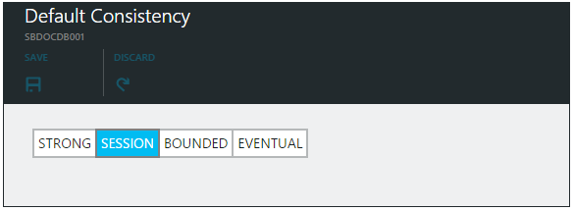
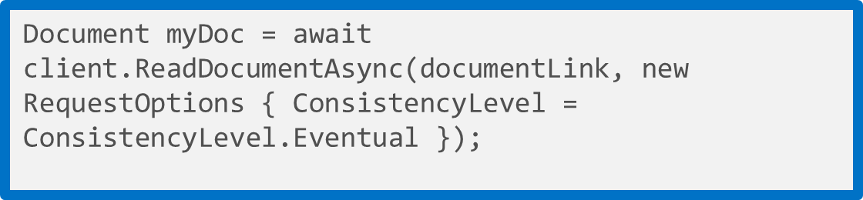
DocumentDB: Consistency Levels
Strong: Guarantees that a write is only visible after it is committed durably by the majority quorum of replicas and reads are always acknowledged by the majority read quorum
Session: Provides predictable read consistency for a session while offering the low latency writes; reads are also low latency as a read will be served by a single replica
Bounded Staleness: Bounded Staleness consistency guarantees the total order of propagation of writes but reads may lag writes by N seconds or operations (configurable)
Eventual: Eventual consistency is the weakest form of consistency wherein a client may get the values which are older than the ones it had seen before, over time
Notes:
Source: http://azure.microsoft.com/en-us/documentation/articles/documentdb-consistency-levels/
Developers are often faced with the challenge of choosing between the two extremes of strong and eventual consistency. The reality is that there are multiple consistency click-stops between these two extremes. In most real world scenarios, applications benefit from making fine grained trade-offs between consistency, availability, and latency. DocumentDB offers four well-defined consistency levels with associated performance levels. This allows application developers to make predictable consistency-availability-latency trade-offs.
All system resources, including database accounts, databases, collections, users, and permissions are always strongly consistent for reads and queries. The consistency levels apply only to the user defined resources. For queries and read operations on user defined resources, including documents, attachments, stored procedures, triggers, and UDFs, DocumentDB offers four distinct consistency levels:
Strong
Bounded staleness
Session
Eventual
These granular, well-defined consistency levels allow you to make sound trade-offs between consistency, availability, and performance. These consistency levels are backed by predictable performance levels ensuring consistent results for your application.

Slide 45
Consistency Levels and Performance
Write operations
Consistency level changes impact request latency
Stronger consistency levels result in higher write latencies
Read operations
Consistency level changes impact throughput
Weaker consistency levels result in higher read throughput
Tip: You can lower the consistency level of a specific read or query request by specifying [x-ms-consistency-level] request header or by using RequestOptions in the SDKs.

Slide 46
Indexing
value
The “write” index for consistent queries
Highly concurrent, lock free, log structured indexing technology developed with Microsoft Research
Optimized for SSD
Resource governed for tenant isolation
Automatic indexing of JSON documents without requiring schema or secondary indices. Configurable via:
Modes
Policies
Paths
Types
string
numbers
object
array
true
false
null
object
{
string
:
value
}
,
array
{
value
}
,
Notes:
Source: http://azure.microsoft.com/en-us/documentation/articles/documentdb-indexing-policies/
DocumentDB is a true schema-free database. It does not assume or require any schema for the JSON documents it indexes. This allows you to quickly define and iterate on application data models. As you add documents to a collection, DocumentDB automatically indexes all document properties so they are available for you to query. Automatic indexing also allows you to store heterogeneous types of documents.
Automatic indexing of documents is enabled by write optimized, lock free, and log structured index maintenance techniques. DocumentDB supports a sustained volume of fast writes while still serving consistent queries.
The DocumentDB indexing subsystem is designed to support:
· Efficient, rich hierarchical and relational queries without any schema or index definitions.
· Consistent query results while handling a sustained volume of writes. For high write throughput workloads with consistent queries, the index is updated incrementally, efficiently, and online while handling a sustained volume of writes.
· Storage efficiency. For cost effectiveness, the on-disk storage overhead of the index is bounded and predictable.
· Multi-tenancy. Index updates are performed within the budget of system resources allocated per DocumentDB collection.
For most applications, you can use the default automatic indexing policy as it allows for the most flexibility and sound tradeoffs between performance and storage efficiency. On the other hand, specifying a custom indexing policy allows you to make granular tradeoffs between query performance, write performance, and index storage overhead.

Slide 47
Indexing Modes and Policies
Set indexing mode
Indexing modes
Consistent
Default mode
Index updated synchronously on writes
Lazy
Useful for bulk ingestion scenarios
Indexing policies
Automatic
Default
Manual
Can choose to index documents via RequestOptions
IndexingDirective = IndexingDirective.Include
Can read non-indexed documents via selflink
var collection = new DocumentCollection
{
Id = “lazyCollection”
};
collection.IndexingPolicy.IndexingMode = IndexingMode.Lazy;
collection = await client.CreateDocumentCollectionAsync(databaseLink, collection);
Set indexing policy
var collection = new DocumentCollection
{
Id = “manualCollection”
};
collection.IndexingPolicy.Automatic = false;
collection = await client.CreateDocumentCollectionAsync(databaseLink, collection);
Notes:
Source: http://azure.microsoft.com/en-us/documentation/articles/documentdb-indexing-policies/#ConfigPolicy
Configuring the indexing policy of a collection
The following sample shows how to set a custom indexing policy during the creation of a collection, by using the DocumentDB REST API.
Note: The indexing policy of a collection must be specified at the time of creation. Modifying the indexing policy after collection creation is not allowed, but will be supported in a future release of DocumentDB.
Note: By default, DocumentDB indexes all paths within documents consistently with a hash index. The internal Timestamp (_ts) path is stored with a range index.

Slide 48
Indexing Paths and Types
var collection = new DocumentCollection
{
Id = “Orders”
};
collection.IndexingPolicy.IncludedPaths.Add(new IndexingPath
{
IndexType = IndexType.Hash,
Path = "/",
});
collection.IndexingPolicy.IncludedPaths.Add(new IndexingPath
{
IndexType = IndexType.Range,
Path = @"/""shippedTimestamp""/?",
NumericPrecision = 7
});
collection.IndexingPolicy.ExcludedPaths.Add("/\"metaData\"/*");
collection = await client.CreateDocumentCollectionAsync(databaseLink, collection);
Hash Index Type
Supported for strings and numbers
Optimized for equality matches
Range Index Type
Supported for numbers
Optimized for comparison queries
String Index Precision
Default is 3
Numeric Index Precision
Default is 3
Increase for larger number fields (epoch timestamps)
Notes:
Source: http://azure.microsoft.com/en-us/documentation/articles/documentdb-indexing-policies/#ConfigPolicy
Index types and precision
The type or scheme used for index entries has a direct impact on index storage and performance. For a scheme using higher precision, queries are typically faster. However, there is also a higher storage overhead for the index. Choosing a lower precision means that more documents might have to be processed during query execution, but the storage overhead will be lower.
The index precision for values at any path can be between 3 and 7 bytes. Since the same path might have numeric and string values in different documents, these can be controlled separately. In the .NET SDK, these values correspond to the NumericPrecision and StringPrecision properties.
There are two supported kinds of index types: Hash and Range. Choosing an index type of Hash enables efficient equality queries. For most use cases, hash indexes do not need a higher precision than the default value of 3 bytes.
Choosing an index type of Range enables range queries (using >, <, >=, <=, !=). For paths that have large ranges of values, it is recommended to use a higher precision like 6 bytes. A common use case that requires a higher precision range index is timestamps stored as epoch time.
If your use case does not require efficient range queries, then the default of hash indexes offer the best tradeoff of storage and performance. Note that to support range queries, you must specify a custom index policy.

Slide 49
Query and indexing tips
Consider query needs and index policies (index policies are currently immutable)
Understand query costs and limits, and avoid scans
Pre-aggregate where possible
Notes:
Source: http://azure.microsoft.com/en-us/documentation/articles/documentdb-indexing-policies/#performance-tuning
As you evaluate different indexing policy configurations, you should measure the storage and throughput implications of the policy through the DocumentDB APIs.
To check the storage quota and usage of a collection, run a HEAD or GET request against the collection resource, and inspect the x-ms-request-quota and the x-ms-request-usage headers. In the .NET SDK, the DocumentSizeQuota and DocumentSizeUsage properties in ResourceResponse contain these corresponding values.

Slide 50
DocumentDB Service Summary
Unique among NoSQL stores
Developed for the cloud and to be delivered as a service.
Truly query-able and is a native JSON store.
Transactional processing through language integrated JavaScript.
Predictable performance and tunable consistency.
DocumentDB for these development scenarios
Customers building new web and mobile cloud based applications.
Rapid development and high scalability requirements.
Query and processing of user and device-generated data.
Customers using K-V stores needing more query and processing support.
Customers running a document store in virtual machines looking for a managed service.
Notes:
To recap, there are a few key points we want you to take a way from this presentation today.
DocumentDB is unique among NoSQL stores
It was developed and is delivered as a service on Azure
It’s truly schema-free and queryable using SQL
It has transactional processing just like a relational database
It has predictable performance and tunable consistency in the cloud.
Your customers should consider DocumentDB for these use cases
Customers building new web and mobile cloud based applications
Rapid Development and High Scalability Requirements
Query and processing of user and device generated data
Customers using K-V stores needing more query and processing support
Customers running a document store in VMs looking for a fully managed service.
Go talk to your customers, find out where document databases are being explored, trialed, or used in production and tell them about DocumentDB.
.

Slide 51
Build your first DocumentDB app today
Get Started …
Sign up for DocumentDB at http://aka.ms/docdbstart
Access and configure your account through http://portal.azure.com
Download an SDK http://aka.ms/docdbsdks, and build a sample at http://aka.ms/docdbsample
Give Feedback …
Ask questions through the forum http://aka.ms/docdbforum
Suggest an idea and vote up other ideas for DocumentDB http://aka.ms/docdbideas
On twitter @documentdb

Slide 52
HOL4 DocumentDB and Azure Websites

Slide 54
Thank you!
© 2015 Microsoft Corporation. All rights reserved. Microsoft, Windows, Windows Vista and other product names are or may be registered trademarks and/or trademarks in the U.S. and/or other countries.
The information herein is for informational purposes only and represents the current view of Microsoft Corporation as of the date of this presentation. Because Microsoft must respond to changing market conditions, it should not be interpreted to be a commitment on the part of Microsoft, and Microsoft cannot guarantee the accuracy of any information provided after the date of this presentation. MICROSOFT MAKES NO WARRANTIES, EXPRESS, IMPLIED OR STATUTORY, AS TO THE INFORMATION IN THIS PRESENTATION.

Slide 55
Security model
Master key
Access control on resources
User operations
Permission operations
Code execution
Notes:
Master key
A master key is a security token to access all resources for an account. Individuals with the key have read and write access to the all resources in the database account. Use caution when distributing master keys. The primary master key and secondary master key are available in the Keys blade of the Azure Preview portal.
Access control on resources
Access to DocumentDB resources is governed by a master key token or a resource token. The master key token is the all access key token that allows individuals to have full control of DocumentDB resources in a particular account. The master key is created during the creation of an account. There are two sets of master keys, the primary key and the secondary key. The administrator of the account can then exercise key rotation using the secondary key. In addition, the account administrator can also regenerate the keys as needed. For instructions on regenerating and rolling keys, see How to manage a DocumentDB account.
Resource tokens are created when users in a database are set up with access permissions for precise access control on a resource. A permission resource contains a hash resource token specifically constructed with the information regarding the resource path and access type a user has access to. The permission resource token is time bound and the validity period can be overridden. When a permission resource is acted upon on (POST, GET, PUT), a new resource token is generated. For information on permissions and resource tokens, see Operations on DocumentDB Permissions.
All REST operations must include the authorization header with the authorization string in order to interact with a resource.
User operations
The DocumentDB API supports basic CRUD operations on the resources under a database account. A user is a logical namespace for scoping permissions on collections, documents, attachment, stored procedures, triggers and user-defined functions. The user construct lives under a database resource thus cannot cross the database boundary it is under. The user resource is represented by users in the DocumentDB REST resource mode. It is a system resource thus contains a fixed schema.
The top-level topic that outlines the basic CRUD operations on the resources under a DocumentDB database account, that itemizes those resources and describes the URLs used to access them is Azure DocumentDB REST API Reference.
Permission operations
The DocumentDB API supports basic CRUD operations on the resources under a database account. Permission is an authorization token associated with a user for authorized access to a specific resource. It is used to manage access to collections, documents, attachments, stored procedures, triggers and user-defined functions for a particular user. You can associate only one permission to a particular resource for a user. For example, MarketingCollection with _rid xynsa== can only be associated with one permission for user JanetSmith@contoso.com. An attempt to add another permission to MarketingCollection for Janet will result in an error (409 Conflict). There are only two permissionMode, All and Read. All will provide read, write and delete access to a resource. Read is self-explanatory. A resource token is created every time a GET or PUT or POST is performed on a permission. By default, the validity period of a resource token is 1 hour. The validity period can be overridden to up to 5 hours.
Code execution security
JavaScript stored procedures and triggers are sandboxed so that the effects of one script do not leak to the other without going through the snapshot transaction isolation at the database level. The runtime environments are pooled but cleaned of the context after each run. Hence they are guaranteed to be safe of any unintended side effects from each other

